Slide 1
Ethical Hacking
Mohona Ghosh

Slide 2
Phishing: What is it?
Phishing – Cybercriminal attempts to steal personal and financial information or infect computers and other devices with malware and viruses
Designed to trick you into clicking a link or providing personal or financial information
Often in the form of emails and websites
May appear to come from legitimate companies, organizations or known individuals
Take advantage of natural disasters, epidemics, health scares, political elections or timely events

Slide 4
Common Baiting Tactics
Notification from a help desk or system administrator Asks you to take action to resolve an issue with your account (e.g., email account has reached its storage limit), which often includes clicking on a link and providing requested information.
Advertisement for immediate weight loss, hair growth or fitness prowess Serves as a ploy to get you to click on a link that will infect your computer or mobile device with malware or viruses.
Attachment labeled “invoice” or “shipping order” Contains malware that can infect your computer or mobile device if opened. May contain what is known as “ransomware,” a type of malware that will delete all files unless you pay a specified sum of money.
Notification from what appears to be a credit card company Indicates someone has made an unauthorized transaction on your account. If you click the link to log in to verify the transaction, your username and password are collected by the scammer.
Fake account on a social media site Mimics a legitimate person, business or organization. May also appear in the form of an online game, quiz or survey designed to collect information from your account.

Slide 6
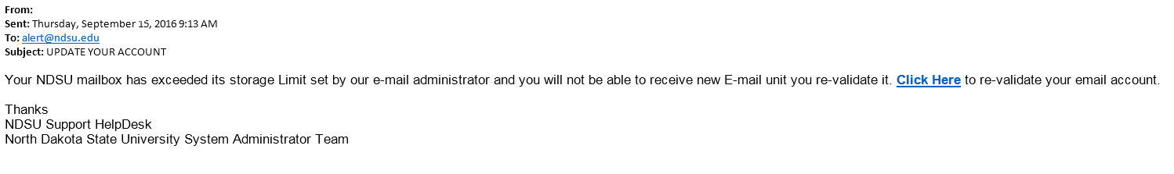
More Examples
Claims to come from the NDSU (North Dakota State University) IT Help Desk and system administrators
References NDSU and North Dakota State University
Calls for immediate action using threatening language
Includes hyperlink that points to fraudulent site

Slide 7
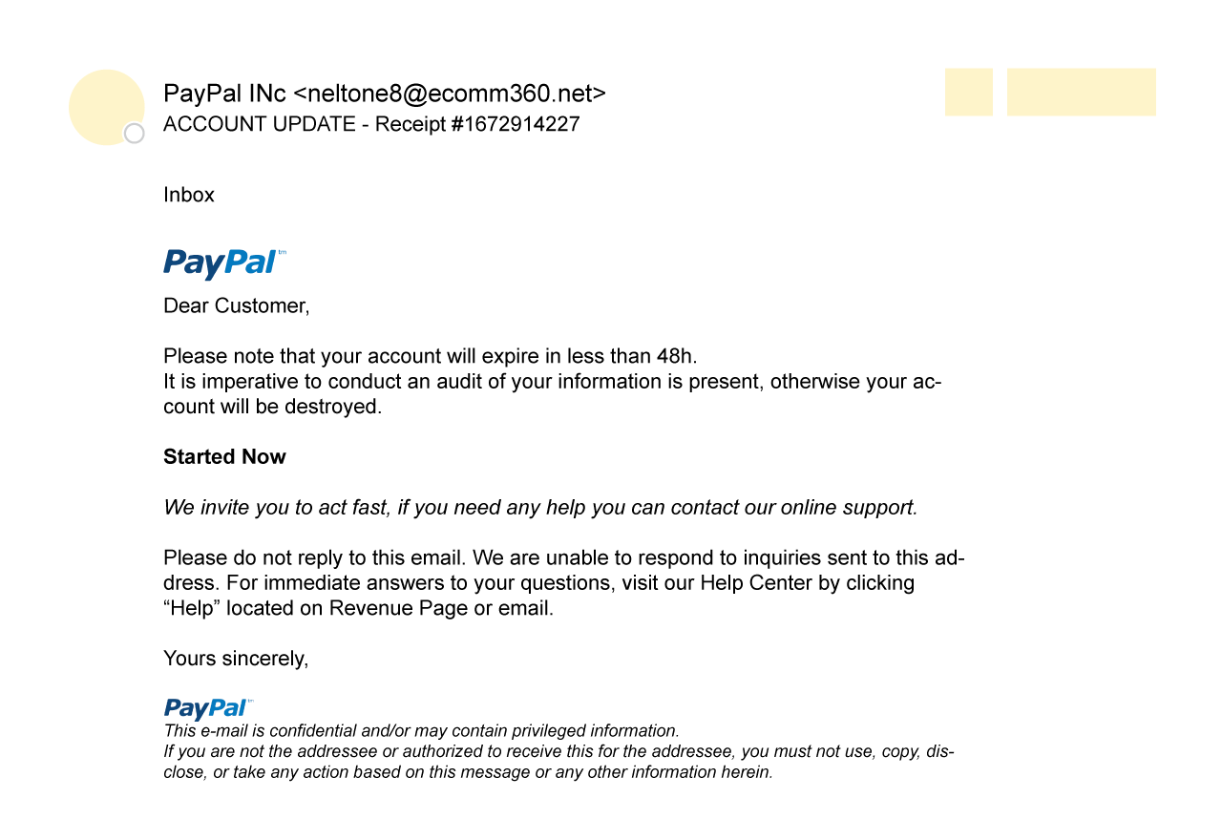
More Examples
Claims to come from PayPal
Includes PayPal logo, but from address is not legitimate (@ecomm360.net)
Calls for immediate action using threatening language
Includes hyperlink that points to fraudulent site

Slide 13
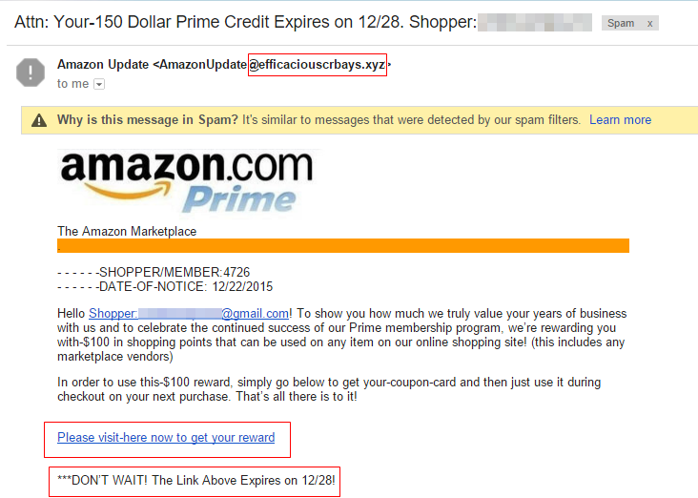
Types of Phishing Attacks
Clone Phishing – Spoofed copy of a legitimate and previously delivered email, with original attachments or hyperlinks replaced with malicious versions, which is sent from a forged email address so it appears to come from the original sender or another legitimate source

Slide 14
Detect a Phishing Scam
Spelling errors (e.g., “pessward”), lack of punctuation or poor grammar
Hyperlinked URL differs from the one displayed, or it is hidden
Threatening language that calls for immediate action
Requests for personal information
Announcement indicating you won a prize or lottery
Requests for donations

Slide 15
How to protect yourself ?
STOP. THINK. CONNECT.
Before you click, look for common baiting tactics
If the message looks suspicious or too good to be true, check for its authenticity
Install and maintain antivirus software on your electronic devices
Use email filters to reduce spam and malicious traffic
Be wary of messages asking for passwords or other personal information
Most reputable businesses and organizations will not ask for this information via email or phone

Slide 16
How to protect yourself ?
Never send passwords, bank account numbers or other private information in an email
Do not reply to requests for this information
Verify by contacting the company or individual, but do not use the contact information included in the message
Do not click on any hyperlinks in the email
User your computer mouse to hover over each link to verify its actual destination, even if the message appears to be from a trusted source
Pay attention to the URL and look for a variation in spelling or different domain (e.g., igdtuw.com vs. igdtuw.ac.in)
Consider navigating to familiar sites on your own instead of using links within messages
Examine websites closely
Malicious websites may look identical to legitimate sites
Look for “https://” or a lock icon in the address bar before entering any sensitive information on a website

Slide 17
How to protect yourself ?
If you might have revealed or shared personal or financial information by mistake, immediately change the password(s) for your account(s). If you use the same password for multiple accounts and sites, change it for each account. Do not reuse that password in the future.

